Slide 1
IBM Watson Studio / IBM Cloud Private 4 Data October 2018 Roy R Cecil Lead Architect Hybrid Data Management Lab Services Europe roy.cecil@pt.ibm.com

Slide 2

Data is the new oil

Slide 3
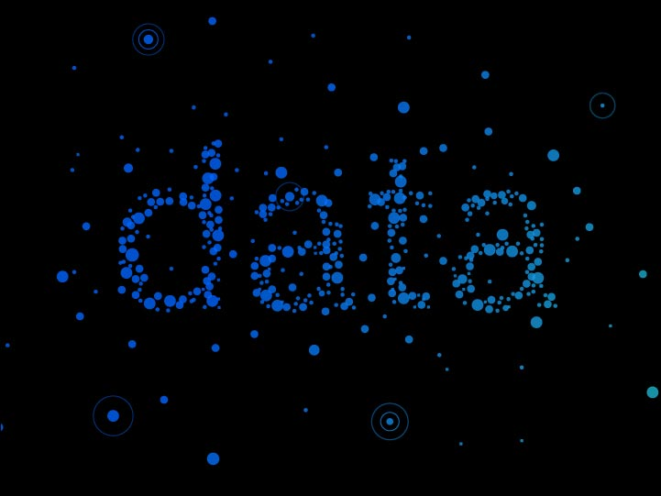
Companies want to transform their
into “Intelligence”

Slide 4

Extracting Value from Data is not always Easy!

Slide 5
Problems Facing Advanced Analytics Projects

Slide 6

Data Resides in Silos

Slide 7
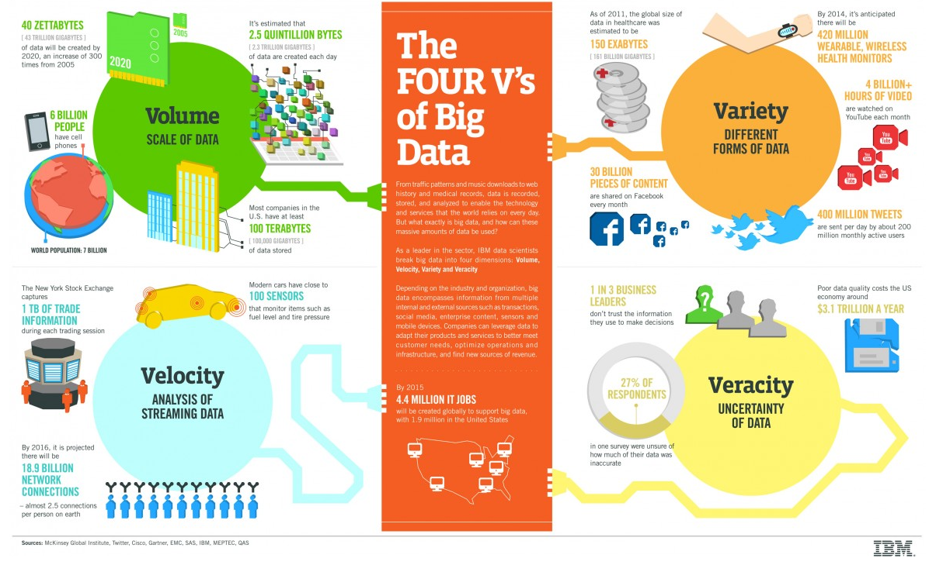
Problems with Scaling, Data in motion , Unstructured data & Trust

Slide 8
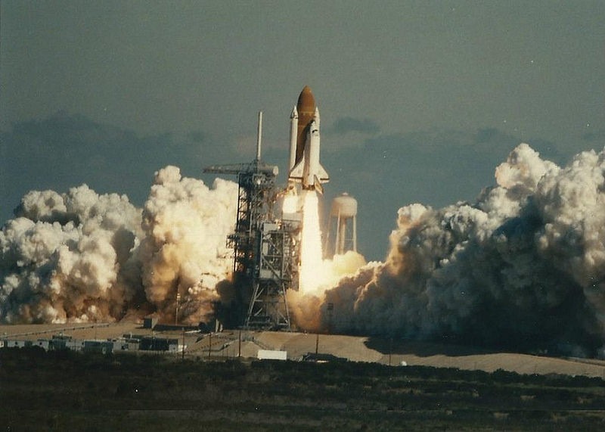
Ability to fail fast!

Slide 9

Data Science is a team Sport

Slide 10






Watson Studio / IBM Cloud Private for Data Helps make your data ready for AI
AI
Embed machine learning everywhere
2
Ladder to AI
Analyze insights on demand
Organize data so it can be trusted
Collect relevant data and make it simple & accessible
Strong Foundation – Built on “IBM Cloud”
1

Slide 11

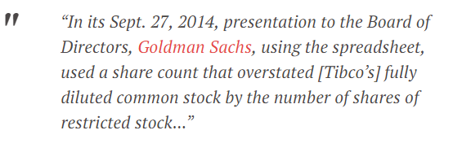
Lets start with Spreadsheet Analytics
Year | Sales
2000 | 234
2005 | 2345
2010 | 2340013
2015 | 30O12333
Total Sales | 2342592
Year | Sales
2000 | 234
2005 | 2345
2010 | 2340013
2015 | 30O12333
Total Sales | 2342592
Year | Sales
2000 | 234
2005 | 2345
2010 | 2340013
2015 | 30012333
Total Sales | 32354925

Slide 12
What are the problems with Spreadsheet Analytics?
No Data Models
Weak Typing
Primitive Error Checking
Data Manipulation is tedious
Problems with scale
Less efficient for concurrent processing.
Non Numeric data ( Text, Images, Sounds etc. )

Slide 13
What is the alternative ?
Data Stores & Data Compute Frameworks

Slide 14
Watson Studio / ICP4D: AI for Smarter Business
Watson Business Solutions
Watson Applications
ISV & Third Party Applications
Compliance Assist
Customer Care
Expert Assist
Voice of the Customer
Watson Assistant
Watson Cybersecurity
Compare & Comply
...
...
...
Watson Studio
Watson APIs
Connect & Access Data
Search & Find Relevant Data
Prepare Data (Ingest, Curate, & Enrich)
Build & Train AI Models
Deploy AI Models
Monitor, Analyze, Manage
Continuous Learning
Watson Machine Learning and Deep Learning as a Service
Watson Knowledge Catalog
Watson Enriched Data &
Analytical Assets
Watson Powered Search & Social Collaboration
Active Policy Enforcement
Model Governance,
Traceability & Lineage
Data Kits
Learns from Small data

Slide 15


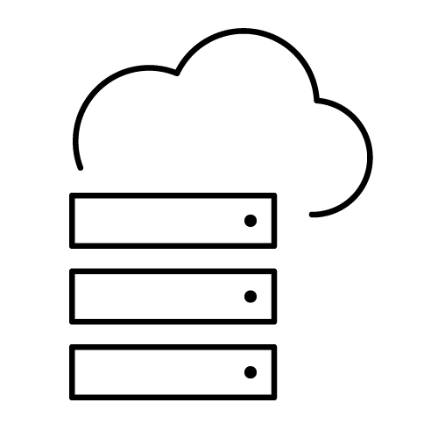




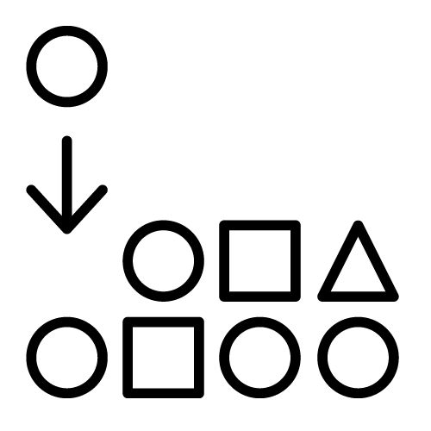


IBM Cloud Private for Data Use Case: Manage All Your Data – regardless of where it lives
Category 1 : Accelerate Data Monetization
IBM Data Virtualization
Your Data Anywhere
End Users
Federated access with autodiscovery
Enterprise Search & Catalog
Data Engineer
Enterprise Search & Catalog
On-Premises
WORKSTREAM
USES
APP
COMMENT
DATASET
INVOKES
RESPONSE
Data Scientists
Private Cloud
PERSON
DATASET
COMMENT
Public Cloud
COMMUNITY
VISUALIZATION
DATASET
Business Analysts
PERSON
Structured & Unstructured Data
MODEL
WORKSTREAM
App Developers
Governance of Consumers and Producers
With lineage, context & metrics
Notes:
”Manage all your Data” – enable governed, secure access to your data regardless of where it lives
Data is spread across the enterprise and there is no easy way to use and leverage / monetize it ... Data as we all know is world's most valuable asset and " Data Virtualization" technology helps access, govern and analyze it irrespective of where it resides
Your data anywhere on public cloud, private cloud, on-premises
Federation with auto-discovery and classification of metadata, profiles, & terms
Enterprise catalog & search, governance of consumers and producers of assets with lineage, context and metrics

Slide 16
Collect
Organize
Analyze
Hybrid Data Management
Unified Governance
and Integration
Data Science and
Business Analytics
All Data
Open Source
Common Application Layer
Write Once, Deploy Anywhere
Find, Catalog and Mask data
Integrate Fluid Data
Built-in Compliance
Machine Learning Powered
Descriptive, Prescriptive, Predictive
Coders and Non-Coders
Advanced Analytics

Slide 17
Useful URL’s Watson Studio http://dataplatform.ibm.com Academic Initiatives https://developer.ibm.com/academic

